Slide 1
AI MEDICAL ASSISTANT
Reasoning Medical Specialist
Fine-Tuned DeepSeek R1
On a Medical QA Dataset

Slide 2

aa
NAME – ABHISHEK YADAV
MASTER’S COMPUTER SCIENCE(AI)
DEEP LEARNING FOR NPL
PROJECT SUMMARY

Slide 3
PROJECT OVERVIEW
In this capstone project, I have created a medical Q&A system using the DeepSeek-R1 LLM and fine-tune it using a chain-of-thought reasoning dataset. The primary objective is to build an intelligent bot that can effectively engage with users by answering questions and providing insights specific to a chosen industry. This project will not only enhance our technical skills but also provide a deep understanding of the chosen industry's nuances, challenges, and trends.

Slide 4
PROJECT LAYOUT
Download Model
Create and setup huggingface API tokens in colab
Setup model and tokenizer.
Setup wandb API
Test DeepSeek R1 on an medical use-case before fine-tuning
Run inference on the model
Define a test question
Tokenize the input
Generate a response
Decode the response tokens back to text
Setup key parms
Tokens per input
Auto detect the data type
Load in 4-bit
Fine tuning & save
Download and prepare dataset(verified medical reasoning data set)
Training prompt
Setup LoRA
Evaluation (Before and After testing)

Slide 5
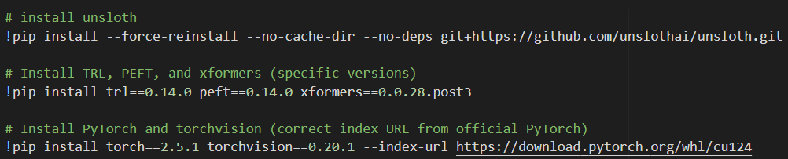


Install required Dependencies.
Purpose:
Unsloth, TRL, PEFT, xformers for fine-tuning, and CUDA-compatible
Bitsandbytes allows 4-bit/8-bit model optimization
Unsloth_zoo provides pre-configured models like deepseek

Slide 6
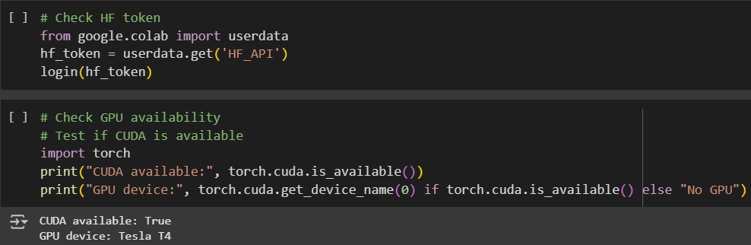
Authentication with HuggingFace and check GPU
Purpose:
Require to load the model form the HuggingFace server using the HuggingFace API_KEY.
Check for the available GPU for our google colab.

Slide 7
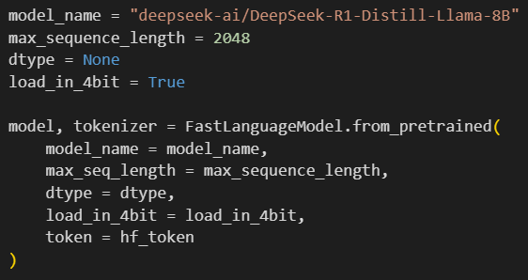
Test DeepSeek R1 on an medical use-case before fine-tuning
Purpose:
We are using a DeepSeek R1, A distilled virsion of LLaMA 8B.
model_name: Specifies the name of the pre-trained language model you want to load form hugging Face.
max_ sequence_length: maximum number of tokens (word/pieces) the model can handle in one input.
2048 is typical for most modern LLMs and balances performance with memory use.
Dtype: data type for model weights is set to none which allows the FastLanguageModel to automatically decide the optimal format based on hardware configuration.
Load_in_4bit: Enables quantization, greatly reduces memory usage and speeds up inference with negligible accuracy loss.
Token: HuggingFace authentication.

Slide 8
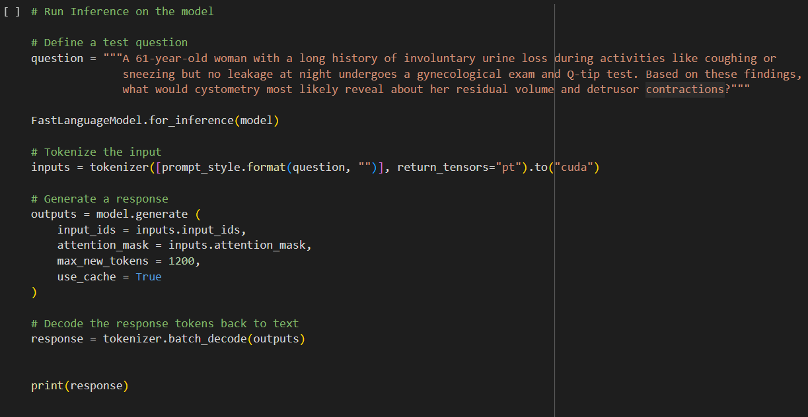
Define a Custom Prompt Template:
This prompt template instructs the model how to behave and how to format its output.
It uses in-context learning, giving the model a detailed setup and tone.
Prepare Model for Inference:
FastLanguageModel.for_inference(model): Prepares model for efficient response generation.
prompt_style.format(question, ""):Fills the {} placeholders with your actual question.
Tokenizer: Converts the text into numerical tokens the model understands.
return_tensors="pt“: Output in PyTorch tensor format.
to("cuda"):Sends the data to the GPU for fast processing.
response = tokenizer.batch_decode(outputs): Converts the generated token IDs back into readable text.

Slide 9
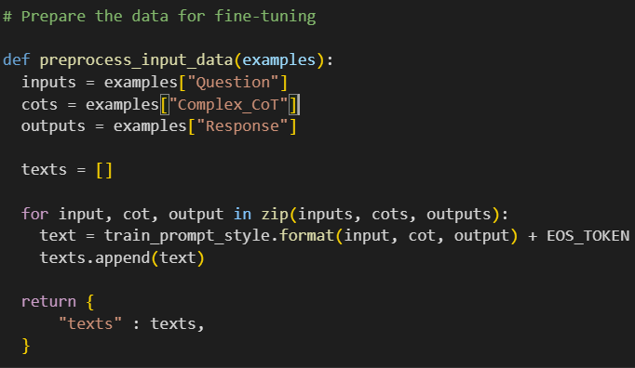
Setup the data for fine tuning
load_dataset: Loads the top 1000 samples from a Hugging Face dataset.
Dataset: FreedomIntelligence/medical-o1-reasoning-SFT, Contains medical questions, chain-of-thought reasoning, and final responses.
EOS_TOKEN: Signals to the model where a response ends.
train_prompt_style: This template provides a structured context:
Instruction: Tells the model it's a medical expert.
Question: The clinical question to be answered.
def preprocess_input_data: Takes a batch of examples with question the medical query, complex_CoT for reasoning steps response for final answer.For each example the function will fills the prompt template with question, thought process and response adds the EOS_TOKEN to the end. And return a sictionary with a single key “texts”.
finetune_dataset: Applies the preprocess_input_data function across all dataset rows in batches . Returns a new formatted prompts ready for training.

Slide 10
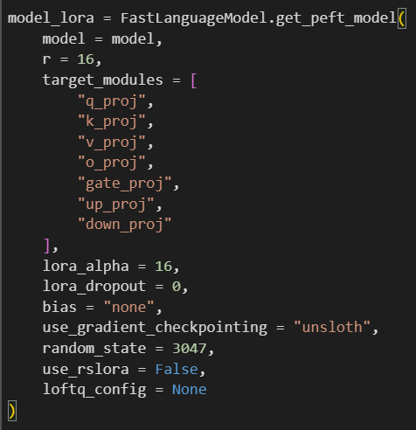
Setup/Apply LoRA finetuning to the model
What is LoRA?
LoRA (Low-Rank Adaptation) is a method to fine-tune large language models efficiently:
It freezes most of the original model weights.
Only a few new trainable parameters (LoRA adapters) are added to specific layers.
This drastically reduces GPU memory usage and training time.
model=model: Base pretrained model (e.g., DeepSeek)
r=16: LoRA rank: controls adapter size and expressiveness
target_modules: LoRA will be applied only to these transformer layers like q_proj, k_proj).
lora_alpha=16: Scaling factor to balance between new and frozen weights.
lora_dropout=0: No dropout applied to LoRA layers (0% randomness)
bias="none“: Don't update any bias terms in the original model
use_gradient_checkpointing="unsloth“:Saves memory by recomputing layers during backpropagation
use_rslora=False: Disable structured sparsity (a more experimental LoRA variant)
loftq_config=None: Leave LoFTQ quantization config as default (not using it here)

Slide 11
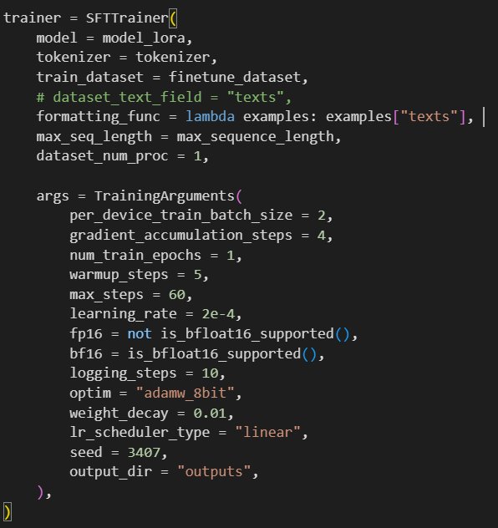
Setup Fine-Tuning Trainer with SFTTrainer
What is SFTTrainer?
SFTTrainer stands for Supervised Fine-Tuning Trainer. It is a training utility provided by the trl (Transformers Reinforcement Learning) library from Hugging Face, designed specifically for fine-tuning large language models (LLMs) with instruction-based datasets.
trainer = SFTTrainer(...):
Use the LoRA-modified model, Tokenizer used to encode/decode text, our formatted dataset with prompt-style texts, Tells trainer to read examples from “texts” column then uses maximum token length per saple and then use the proc=1 which shows the number of parallel preprossing process.
args = TrainingArguments(...):
The TrainingArguments block defines how the model is trained. It sets a small batch size with gradient accumulation to simulate a larger batch. Training runs for 1 epoch or 60 steps with a warmup of 5 steps. Mixed precision fp16 or bf16 is used for efficiency. Logging happens every 10 steps, and the adamw_8bit optimizer helps reduce memory use. The learning rate follows a linear schedule, and outputs are saved to the outputs folder. A seed ensures reproducibility.

Slide 12
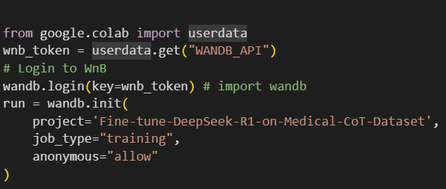


Setup Weights & Biases (W&B) Logging
W&B (Weights & Biases) is a tool used for tracking machine learning experiments (loss curves, metrics, GPU usage, etc.).
userdata.get("WANDB_API"): retrieves your W&B API key securely (in Colab) and authenticates your session so logs can be sent to your W&B account.
Starts a new experiment log under the project: "Fine-tune-DeepSeek-R1-on-Medical-CoT-Dataset".
job_type="training“: labels the run type.
anonymous="allow“: enables logging even if you're not logged into W&B via browser.
trainer_stats = trainer.train()
Calls the .train() method of the SFTTrainer.
This triggers the full training loop.
Iterates over the dataset.
Optimises the model using the defined training arguments.
Logs metrics to the console and W&B.

Slide 13
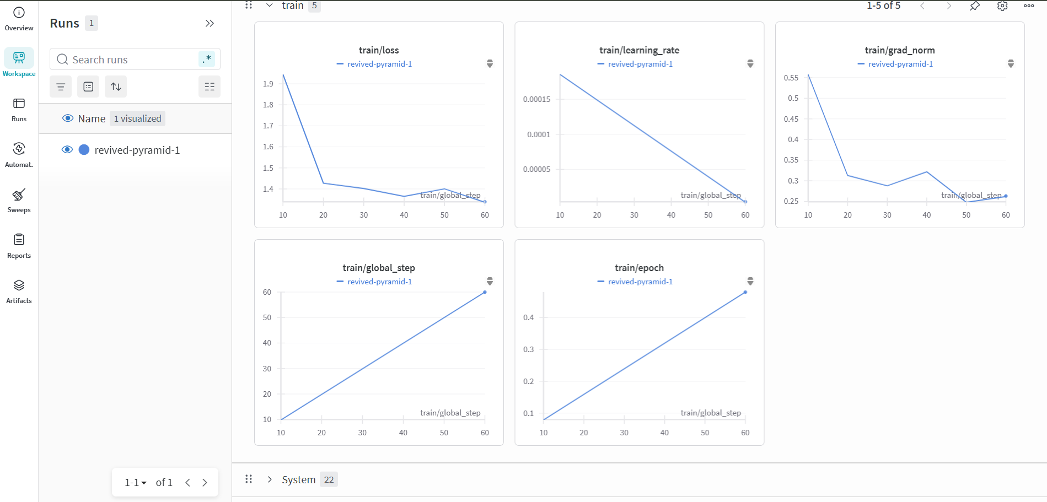
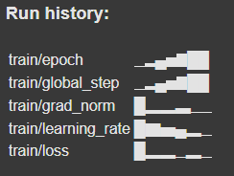
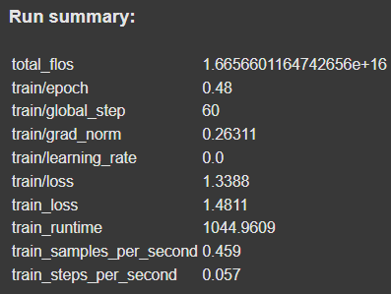

Slide 14
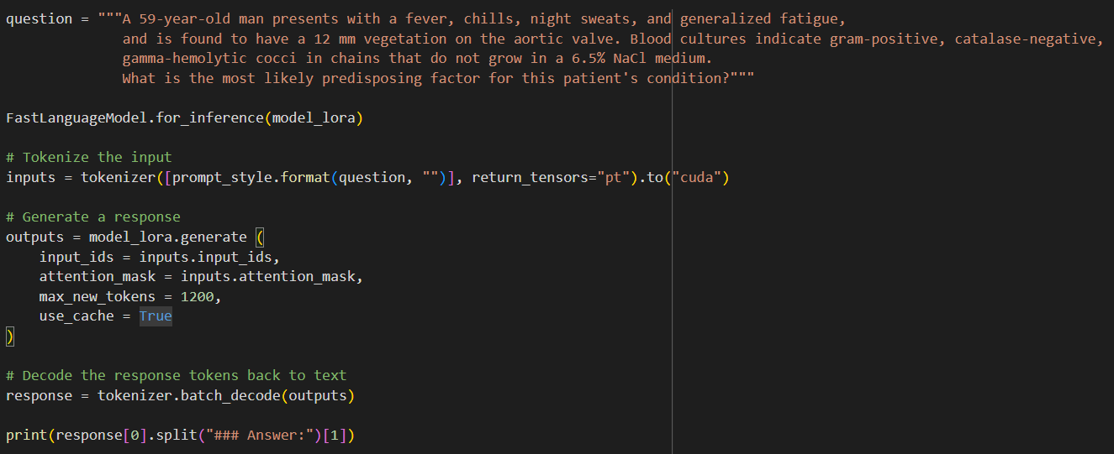
Testing after fine-tuning
The model is asked to identify the likely underlying condition (e.g., colon cancer, poor dental hygiene, etc.)
Puts the fine-tuned model in inference mode, disabling training-specific features like dropout.
Formats the question using the same prompt_style used during training (important for consistency). Converts it to PyTorch tensors and moves to GPU for faster inference.
Uses the fine-tuned model to generate a response.
max_new_tokens=1200 allows for a long, detailed output.
use_cache=True: makes generation faster by caching intermediate layers.
Converts generated tokens back into human-readable text.
Splits the output at "### Answer:“to extract just the model's answer.

Slide 15
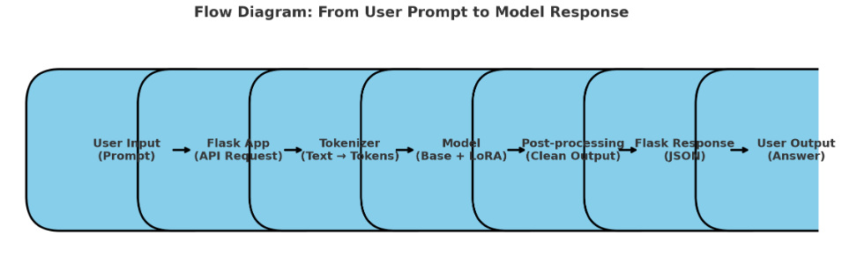
Frontend Application development
Import required libraries Flask, transformers, peft, torch, ngrok
Define model path – BASE_MODEL, TOKENIZER_PATH, LORA_PATH
Set device – Chooses GPU if available, else falls back to CPU
Loads the tokenizer from the Google Drive path for text preprocessing.
Configures quantization using BitsAndBytesConfig (saves memory, speeds up inference).
Tries to load the LoRA fine-tuned adapter from Google Drive.
Disables training mode, optimizes inference.
Points Flask to templates and static folders for frontend HTML & assets.
Define routes.
Formats input into a Q&A style prompt template.
Converts text into tensors using tokenizer.
Generate response using model.
Post-process model output
Sends cleaned output as JSON response to the frontend.
Generates a public URL to share and access the Flask app.
Runs app locally on port 5000.

Slide 16
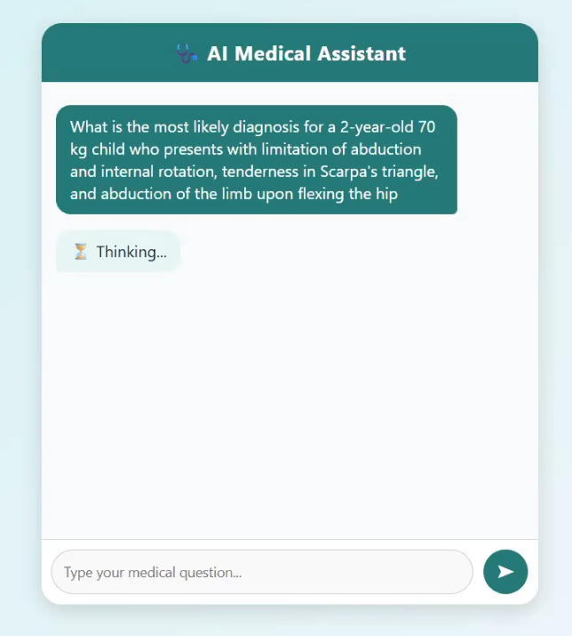
Application preview

Slide 17





TOOLS AND TECHNOLOGIES
Google Colab Notebook
HuggingFace (Model Hosting, Dataset)
Torch
Unsloth (optimized Fine-tuning)
Weight & Biases (Expirement tracking)

